Slide 1
Smart Water Management Lakes
Final Project Presentation
M.S. Data Science
June 2025
Prof. Flora Amato
Zaighum Jawad Aslam, Samra Amjed, Airaf Siddique

Slide 2
Project Objective
The primary objective of this project is to develop an effective time series forecasting framework for smart water management, specifically focusing on predicting lake water levels and flow rates. Using historical hydro-meteorological data, the project aims to:
Understand the relationships between key environmental variables such as rainfall, temperature, inflow, and lake level.
Identify and analyze seasonal and trend patterns in the dataset.
Apply and compare statistical forecasting models (ARIMA) and advanced machine learning models (Facebook Prophet) for accurate predictions.
Evaluate model performance using metrics such as RMSE, MAE, and R² to assess their forecasting reliability.
Support proactive decision-making in water resource planning and management through data-driven insights.

Slide 3
Dataset Overview
Consisting of 6,603 rows and 5 columns, capturing the following features:
Date: Sequential index representing each day of observation.
Mean_Rainfall: Daily average rainfall (in millimeters).
Mean_Temp: Daily average ambient temperature (in degrees Celsius).
Actual_Flow_Rate: Daily water inflow to the lake (in cubic meters per second).
Actual_Lake_Level: Daily observed lake water level (in meters).
All features are numeric and stored in appropriate data types (float64).
No missing values but still checked for analysis.
Outliers presence affecting dataset which are to be removed by IQR Method.

Slide 4
Exploratory Data Analysis
• Visualizations: Boxplots, Histograms.
• Outlier detection using IQR Methods.
• Correlation heatmap to identify variable relationships.

Slide 5
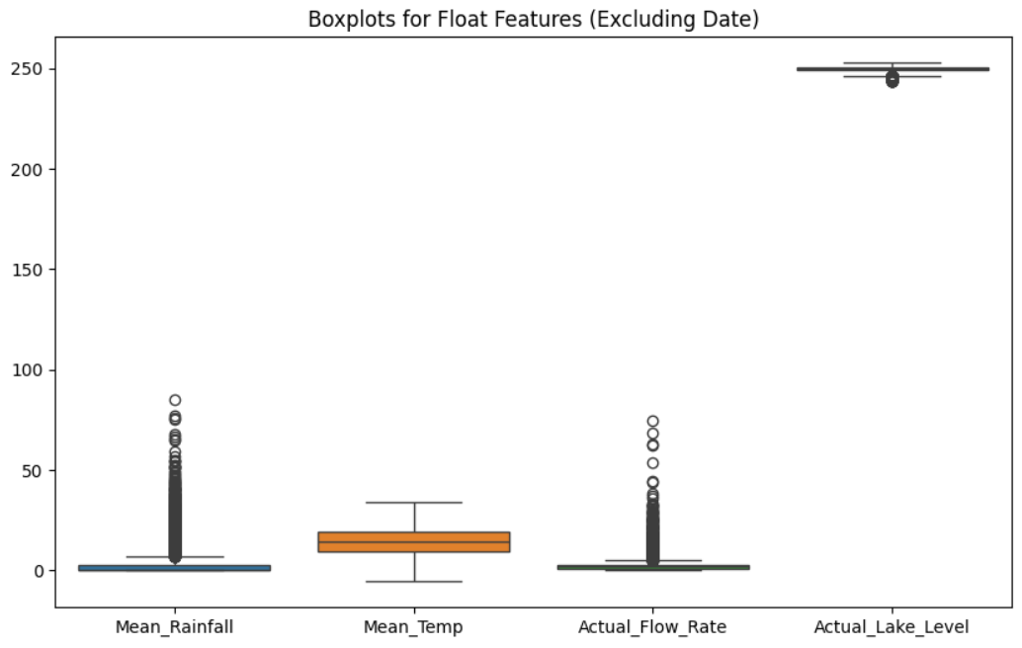
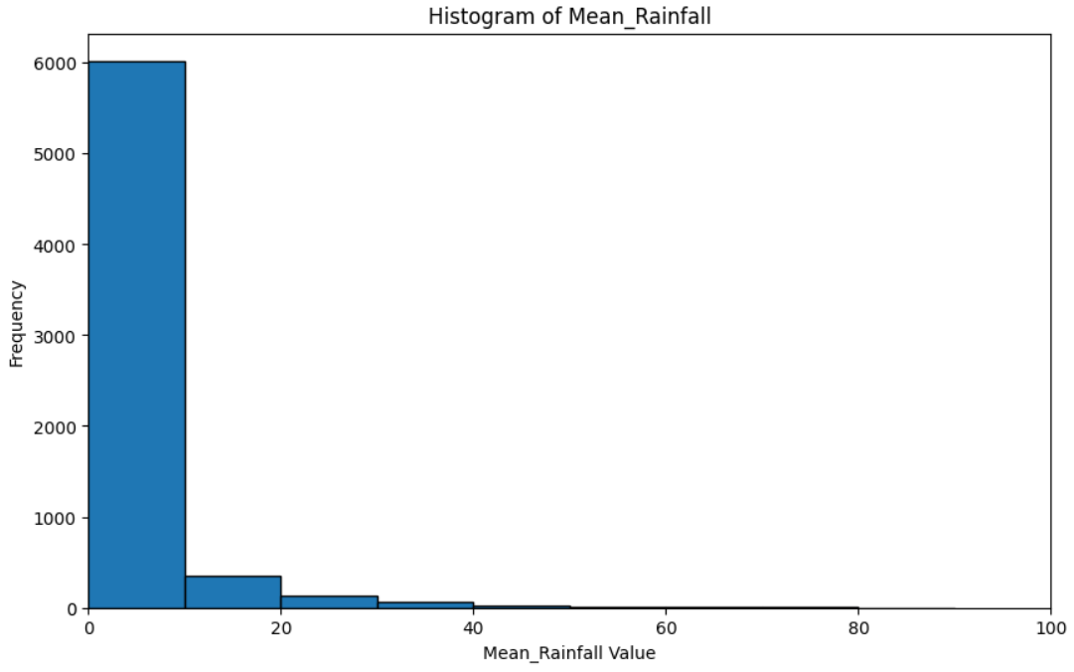
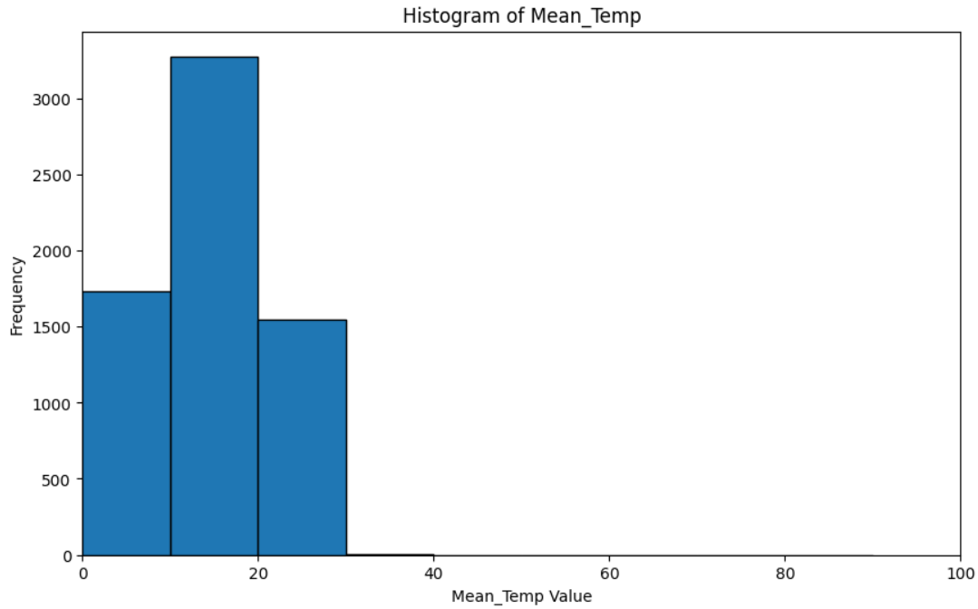
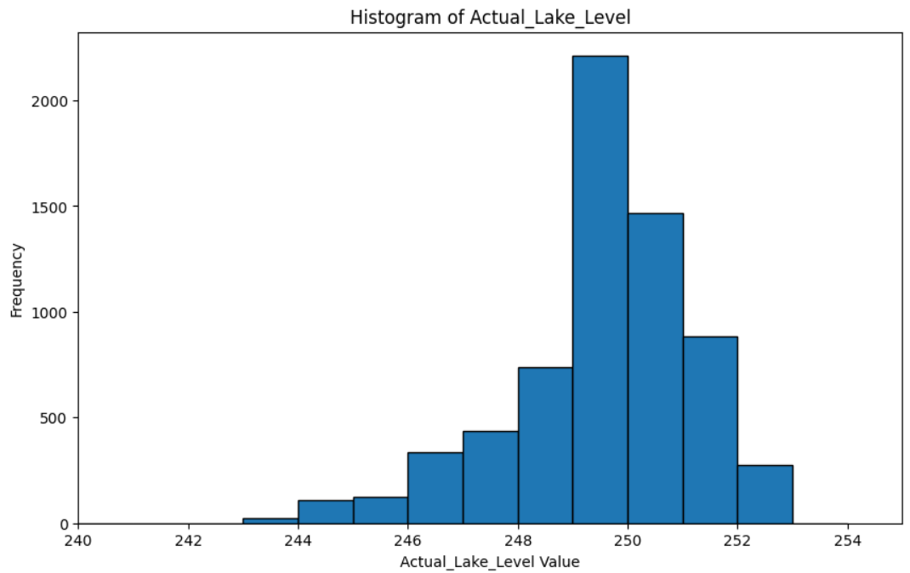
Visualizations

Slide 6
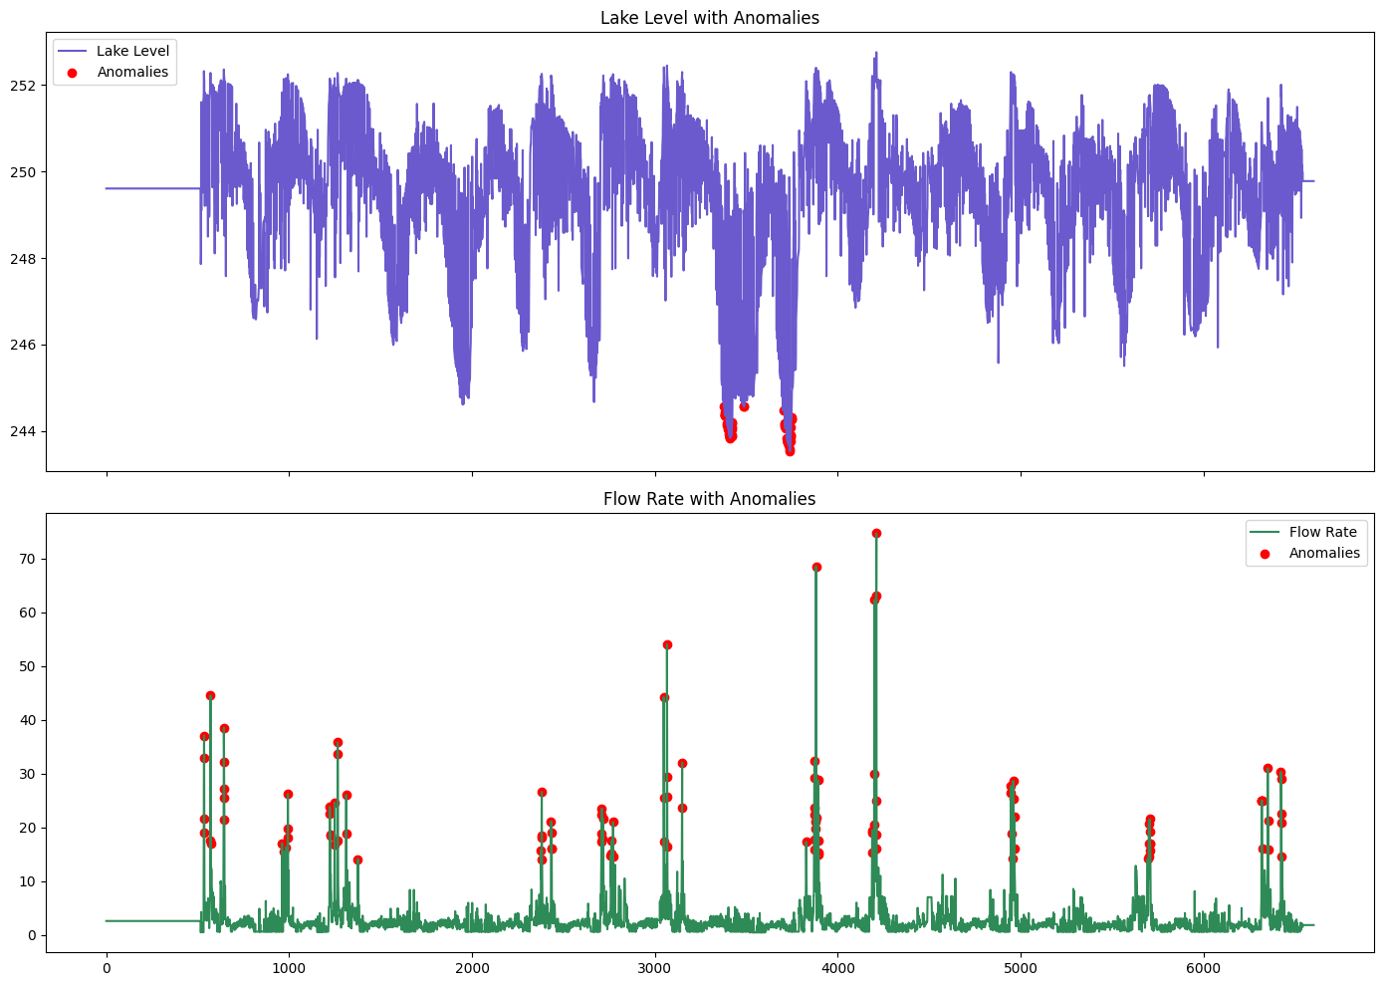
Anomalies Detection
Time-series of actual lake levels is shown in purple.
Red dots indicate anomalies detected using the Z-score method
Z-scores > ±3 were flagged as outliers, representing abnormal dips in lake levels.
These may be due to extreme weather events, infrastructure failures, or sensor errors.

Slide 7
Continued’
Green line represents actual daily inflow into the lake.
Anomalies (in red) reflect extreme spikes, likely caused by sudden rainfall events or operational changes.
Such data points can distort forecasting if not handled properly.

Slide 8
IQR Method
Implemented a custom function to detect and remove outliers using the Interquartile Range (IQR) technique.
For each numeric column:
Calculated Q1 (25th percentile) and Q3 (75th percentile).
Defined outlier boundaries as: Lower Bound = Q1 - 1.5 × IQR Upper Bound = Q3 + 1.5 × IQR
Rows with values outside these bounds were considered outliers and removed.

Slide 9
Outliers Removal (Results)
Mean_Rainfall Mean_Temp Actual_Flow_Rate Actual_Lake_Level | 763 0 656 339
Mean_Rainfall: 763 outliers — frequent extreme spikes due to irregular rainfall events.
Actual_Flow_Rate: 656 outliers — high variance linked to sudden inflows or measurement errors.
Actual_Lake_Level: 339 outliers — abnormal dips or peaks in lake levels, possibly due to operational disruptions or sensor faults.
Mean_Temp: 0 outliers — temperature remained within normal variation bounds throughout the dataset.
Original dataset size: 6,603 rows, After outlier removal: 4,697 rows

Slide 10
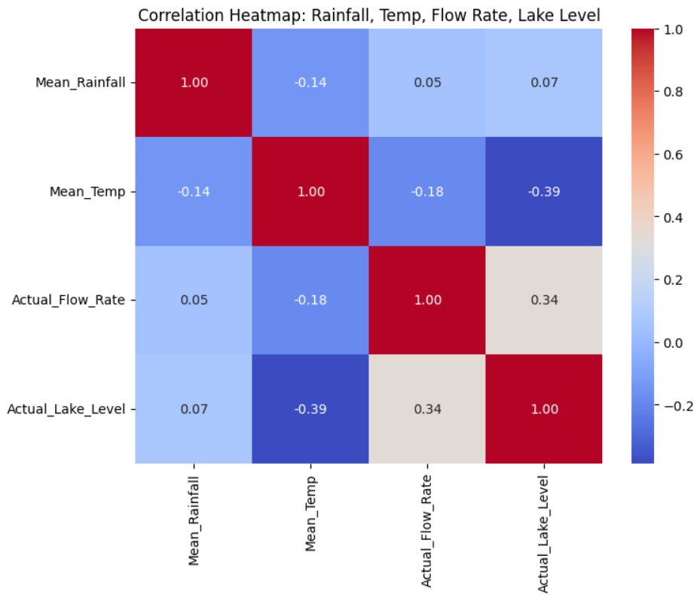
Correlation Heatmap

Slide 11
Correlation Heatmap Analysis
Key Observations:
Actual_Flow_Rate and Actual_Lake_Level show a moderate positive correlation (0.34) Suggests higher flow rates tend to raise lake levels.
Mean_Temp has a moderate negative correlation with Actual_Lake_Level (-0.39) Likely due to evaporation or seasonal influences.
Mean_Rainfall shows very weak correlation with lake level (0.07) Possibly due to lag effects or indirect impact.

Slide 12

Hypothesis Thesis
Purpose: To determine whether the Actual_Lake_Level time series is stationary—required for ARIMA modeling.
Test Used: Augmented Dickey-Fuller (ADF) Test
Hypotheses:
H₀: Series is non-stationary
H₁: Series is stationary
Decision Rule:
If p-value < 0.05 → Reject H₀ → Stationary
If p-value ≥ 0.05 → Fail to reject H₀ → Non-stationary

Slide 13
Transformation On Dataset
A date function helped to incorporate the dates from a given range to a particular range.
Generated a daily date range starting from January 1, 2012, matching the number of records in the cleaned dataset (4,697 rows).
Replaced the original date index with this new range to create a chronologically accurate time series.
Ensure the date column is in proper format for time series modeling.

Slide 14
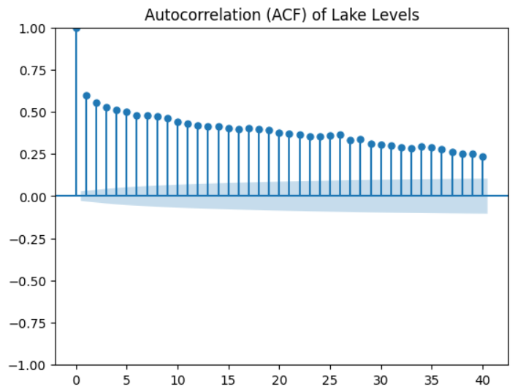
Auto Correlation Analysis
The lake level data is not random — it shows a pattern over time.
The ACF plot confirms that past values can help predict future ones.
This supports the idea that you can use ARIMA or other time series models for forecasting lake levels.

Slide 15
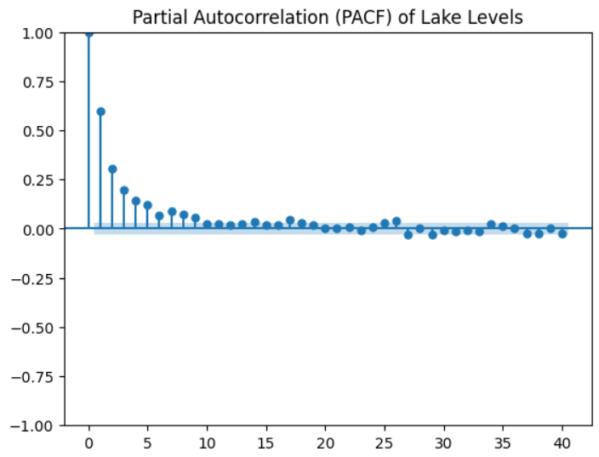
Partial Auto Correlation Analysis
Y-Axis (Vertical): Shows the strength of correlation (from -1 to +1).
Positive values (1.0): A high value at a lag means the lake level at that time strongly influences the current level.
Negative values (e.g., -0.5): A low value suggests an inverse relationship (e.g., high past levels correlate with low current levels).
X-Axis (Horizontal): Shows the time lags (e.g., 0, 5, 10, ... days/months).

Slide 16
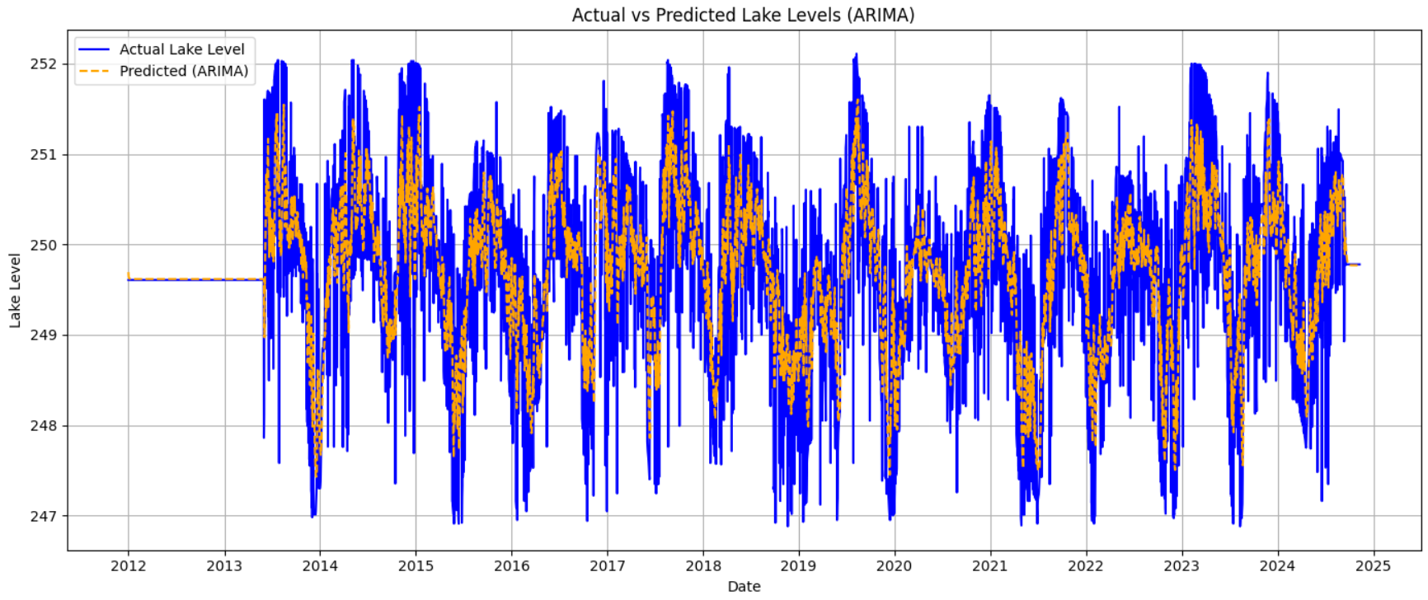
Modeling (ARIMA)
Model Configuration:
Used ARIMA(1, 0, 1) model on the
p = 1 (autoregressive term)
d = 0 (no differencing, as the series is stationary)
q = 1 (moving average term)
Procedure:
Applied the model to cleaned daily data from 2012 onward.
Fitted the model and generated in-sample predictions across the entire dataset.

Slide 17
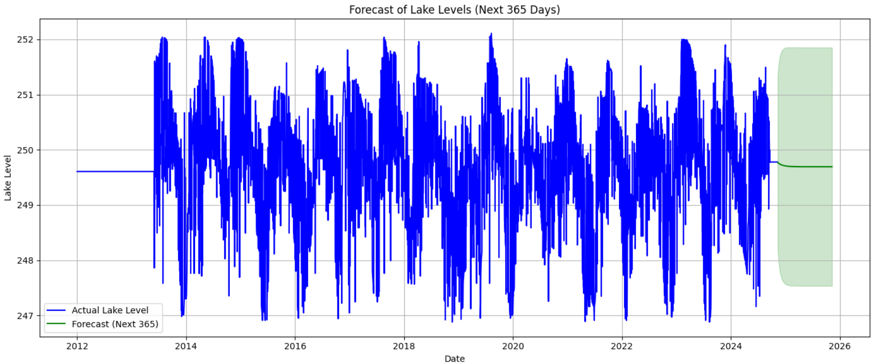
Continued’
Extended the ARIMA(1,0,1) model to generate a 1-year forecast (365 days).
Forecast starts from the last observed date in the dataset and projects forward daily.
Green line: Predicted lake levels
Shaded area: 95% confidence interval, indicating uncertainty bounds of the forecast

Slide 18
Interpretation of Metrics
RMSE interprets on average, your model's lake level predictions deviate by approximately 1.006 units (meters or your dataset’s lake level unit) from the true values.
MAE on average, your forecast is off by 0.80 units from the actual observed lake levels.
A negative R² suggests that the model performs worse than simply predicting the mean of the observed values. It indicates that the model isn't capturing the variance in the data effectively for the forecast horizon.
This could be due to high variance, model overfitting or underfitting, long term prediction.

Slide 19
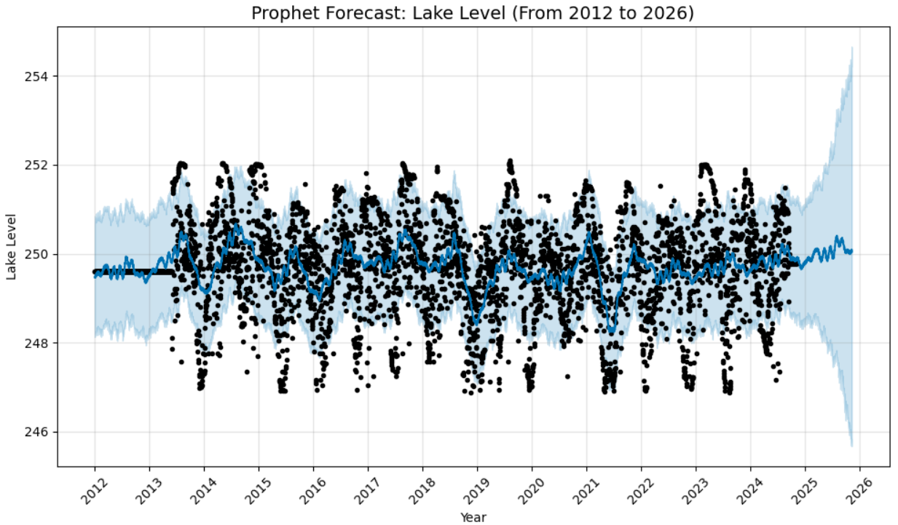
Time Series Analysis : Prophet Model
Ideal for datasets with:
Seasonality (daily, weekly, yearly patterns) ,Missing data or outliers, Irregular trends and holidays
Decomposes time series into three components:
Trend – Long-term increase or decrease
Seasonality – Periodic patterns (e.g., yearly)
Noise – Random fluctuations

Slide 20
Interpretation Of Lake Levels (Prophet)
The blue line is the forecasted trend
The black dots represent actual lake levels.
The shaded blue region indicates Prophet’s confidence interval
The model captures yearly fluctuations in lake level well.
The model closely follows the actual values with clear periodic oscillations, showing it successfully captures seasonality and long-term trends.
Despite the daily fluctuations and noise, the model maintains a stable central trend line around 249.5 to 250.5 units.
The forecasted mean lake level remains fairly stable around 249.5–250.5 units from 2012 through the forecast horizon (2026), indicating no major long-term upward or downward trend.
The repeating waves in the forecast reflect strong annual seasonality, which Prophet captures via Fourier terms.
The 95% prediction interval covers a range from ~247.5 to ~254.5 in 2026, meaning there’s a 5% chance the real value lies outside this range.

Slide 21
Continued’
Residuals Analysis:
Since the predicted line closely follows the actual black dots during the historical period:
The residuals are likely small.
This implies a low error and good fit.
However, the forecasted region (after 2024) shows wider uncertainty bands, implying:
Residual variance may increase in the future.
The model becomes less confident, and actual vs predicted may differ more.
Residuals help validate model performance.

Slide 22
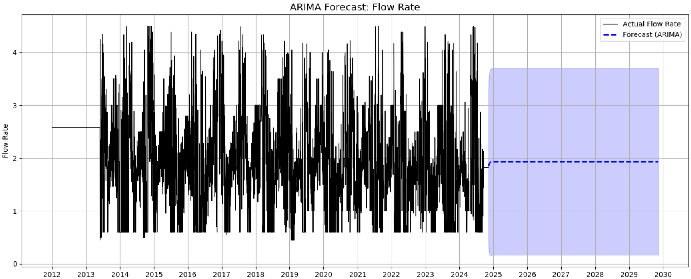
Arima (Flow Rate)
ARIMA(1, 0, 1) Model
The black line represents the actual flow rate fluctuations over the years.
The blue dashed line shows the predicted future trend, which stabilizes around the historical average.
The light blue band indicates prediction uncertainty, wider bands imply more uncertainty farther into the future.

Slide 23
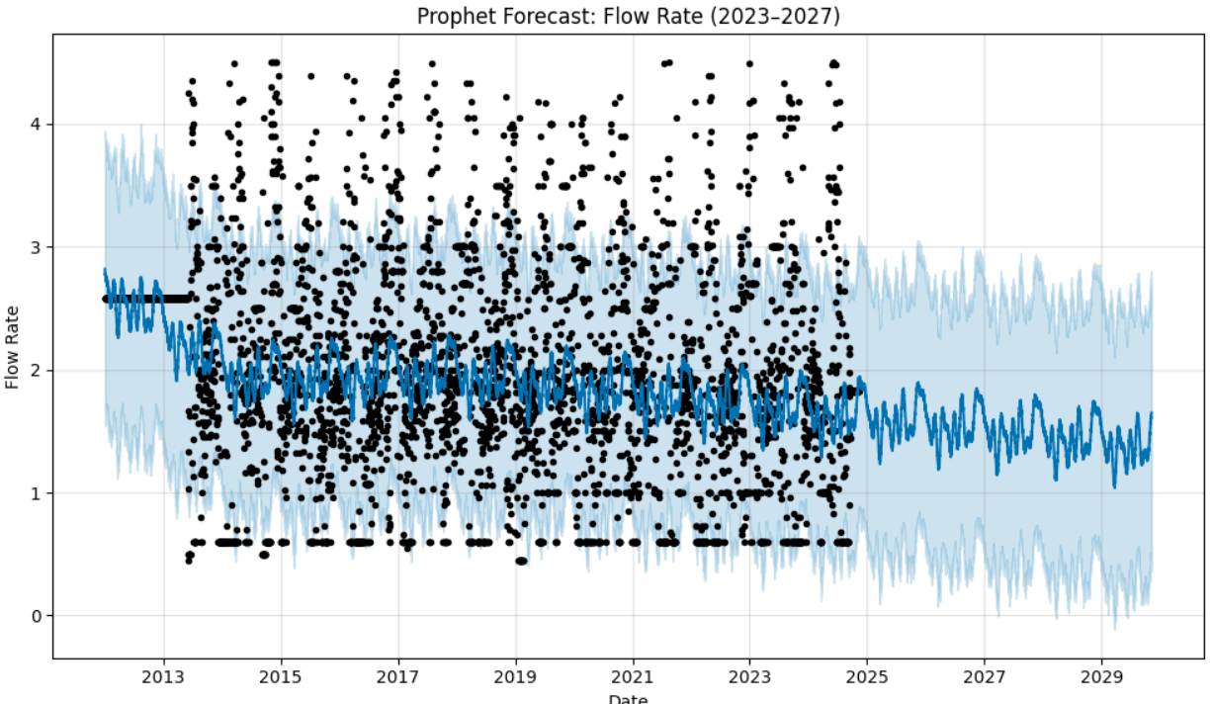
Prophet Model (Flow Rate)
The trend shows a declining pattern, the model captures strong seasonal patterns, likely driven by monsoons or irrigation cycles.
Noise and outliers in past data are handled gracefully by Prophet's robust nature.
Uncertainty increases toward 2027, especially after 2025, highlighting limitations in long-term predictions.

Slide 24
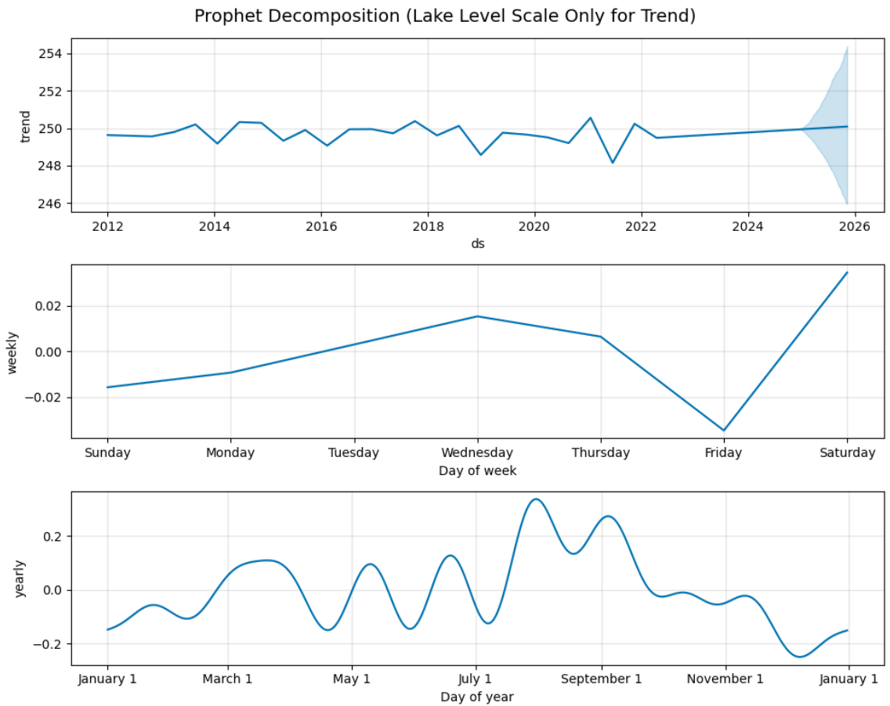
Decomposition Of Prophet Properties (I)
From 2012 to 2024, the lake level remains fairly stable around 249.5–250 units, with mild dips and peaks.
The lake level tends to rise slightly on weekends, especially Saturdays, and drops on Fridays.
Peaks are observed around mid-year (July–September), suggesting higher lake levels during monsoon or wet seasons.

Slide 25
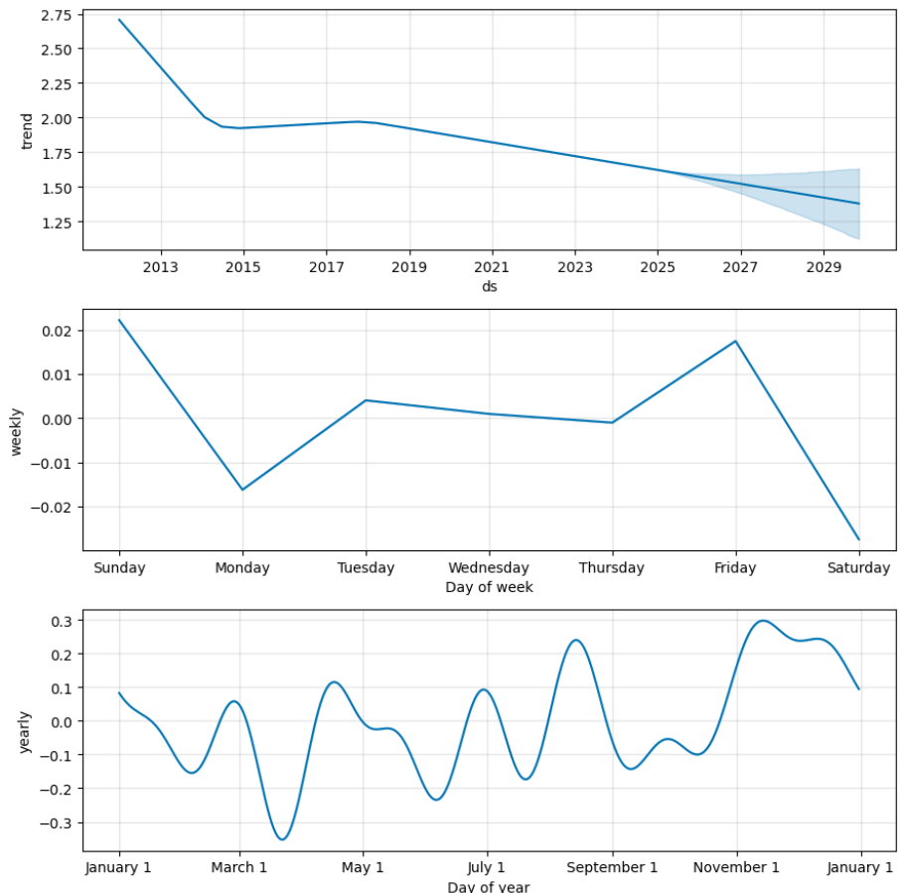
Decomposition Of Prophet Properties (II)
This suggests a long-term downward trend, possibly due to climate change, reduced rainfall, increased consumption, or policy shifts.
Flow rate is highest on Sundays and Fridays, and lowest on Mondays and Saturdays.
Flow rate dips significantly in March and again in late summer (July–August). Peaks are observed around April, September, and November

Slide 26
Evaluation Metrics (II)
The RMSE and MAE values indicate that the model's average prediction error in flow rate is relatively low, hovering around 0.92 and 0.73 units respectively. This suggests that while the model captures the general trend and magnitude of flow rate fluctuations reasonably well, it still exhibits some deviation from actual observations, especially during periods of variability.
However, the R² score of -0.0462 highlights a critical insight: the model does not explain the variance in the flow rate data better than a simple mean-based baseline. A negative R² score implies that the model’s

Slide 27
Why LSTM for Time-Series?
Captures long-term dependencies and trends in sequential data.
Suitable for non-linear, complex time-series relationships.
Overcomes limitations of traditional models like ARIMA/Prophet.
Daily lake level data (2012–2024) used.
Applied Min-Max Scaling for normalization.
Created rolling window sequences (30 days).

Slide 28
Model Preparation
Input shape: (samples, 30 days, 1 feature)
LSTM layer: 64 units with ReLU activation.
Dense output layer to predict next lake level

Slide 29
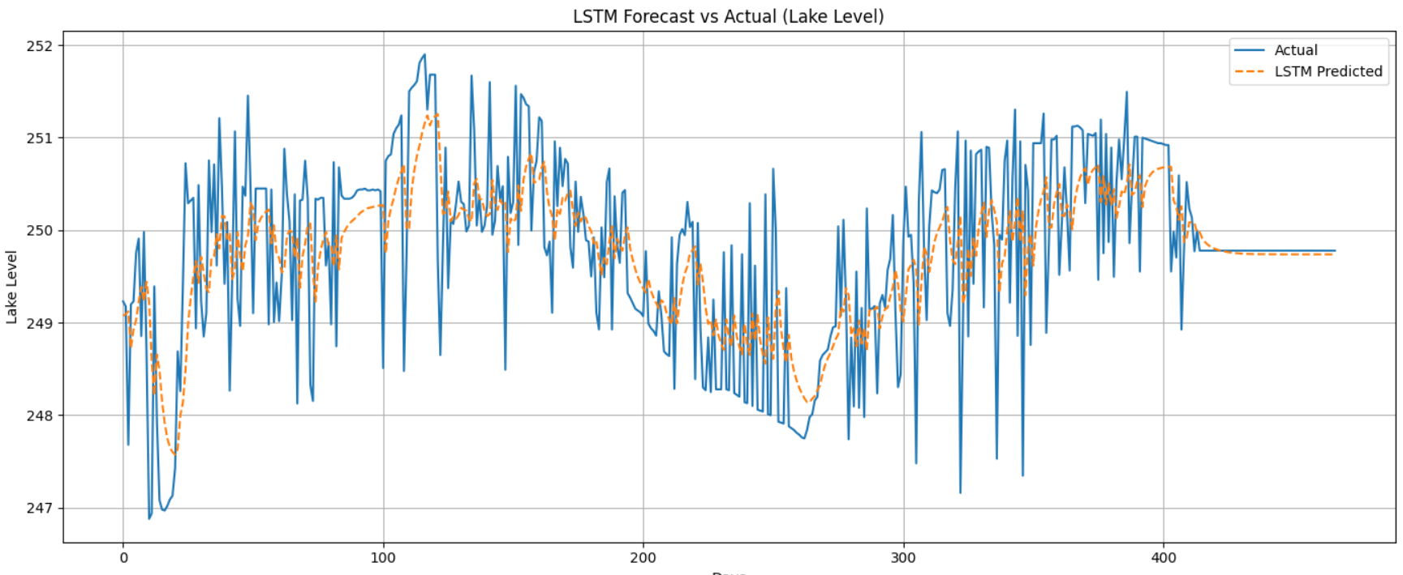
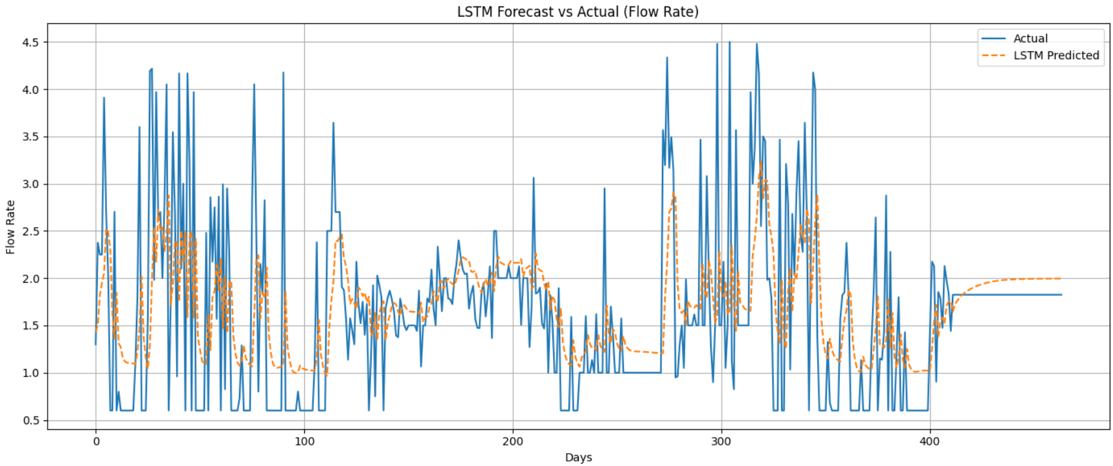
LSTM (Approach)
Overlay plot comparing LSTM predictions with actual values.
Perfect Fit / Good Fit , Robust and seasonality captured strongly.
Can interpret Lake Level, Flowrate effectively even after introducing noise or not.

Slide 30
Evaluation Metrics (iii)
LSTM Evaluation for Lake Level:
RMSE: 0.7849
MAE : 0.6027
R² : 0.4225
LSTM Evaluation for Flow Rate: RMSE: 0.8066
MAE : 0.5733
R² : 0.2015

Slide 31
Conclusion
Conducted detailed Exploratory Data Analysis (EDA), outlier detection, and stationarity testing to ensure data quality and model reliability
Stationarity and anomaly handling crucial for forecasting.
Utilized time-series forecasting models (ARIMA & Prophet). Prophet is better when it comes to capturing seasonality behavior.

Slide 32
Future Work
• Incorporate external factors (e.g., dam operations).
• Use real-time data with interactive dashboards (e.g., Streamlit).
Explore dataset and add noise, additions where implacable for extensive processing.

